Slide 1
Relative clauses and pronouns
Author: Sixten Hinnov

Slide 2
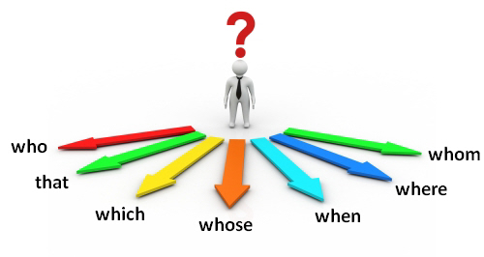
Relative pronouns

Slide 3
Relative pronouns introduce relative clauses
The most common relative pronouns are:
Who (kes) – subject, refers to people
Whom (keda, kellele) –object, refers to people
That (mis, kes) – refers to people and things
Whose (kelle) – the possessive of who and which
When (millal, kuna) – refers to time
Where (kus, kuhu) – refers to place
Why (miks) – refers to reason
NB! WHAT IS NOT A RELATIVE PRONOUN! It can be used in a meaning „the things which“.
We can´t give you what you need.

Slide 4
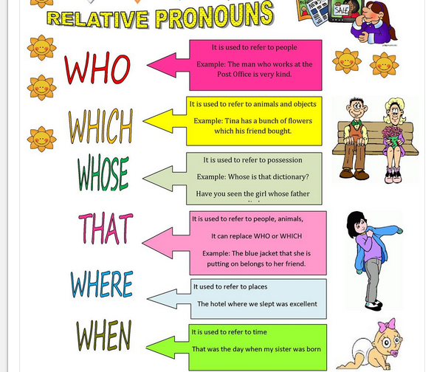

Slide 5
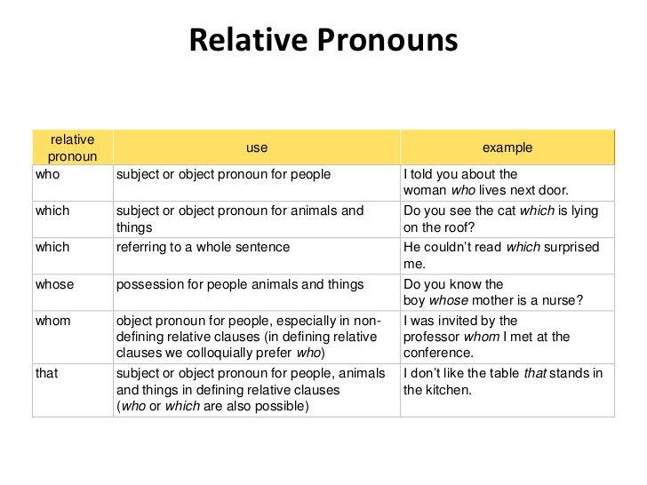

Slide 6
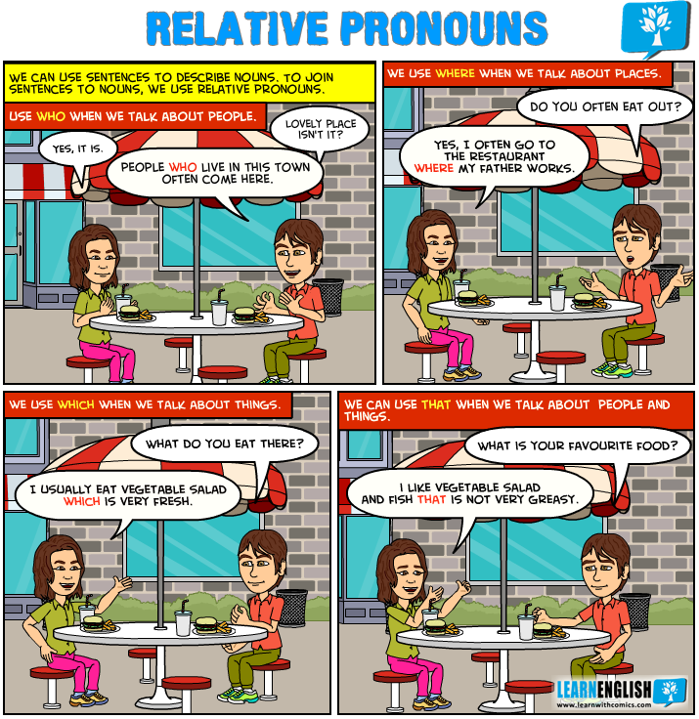

Slide 7
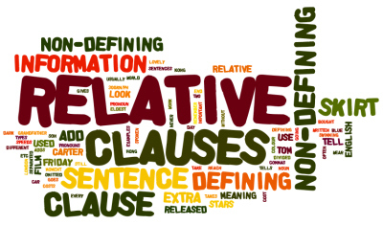
Relative clauses (kõrvallaused)

Slide 8
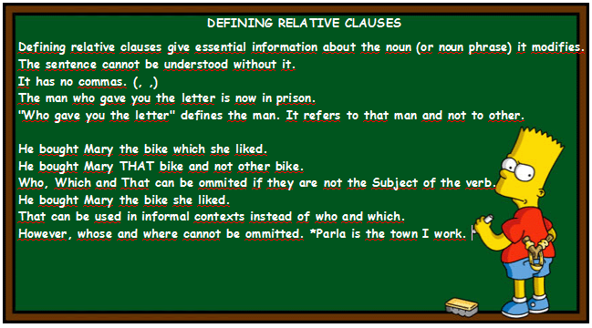

Slide 9
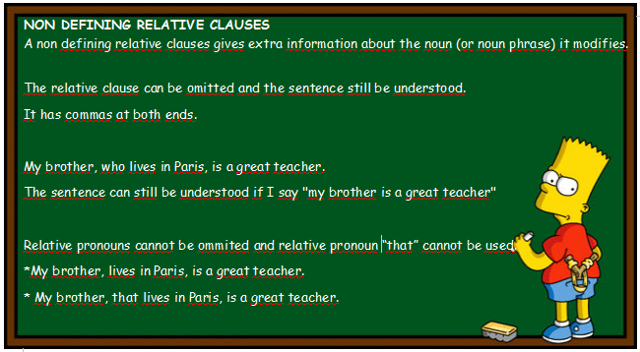

Slide 10
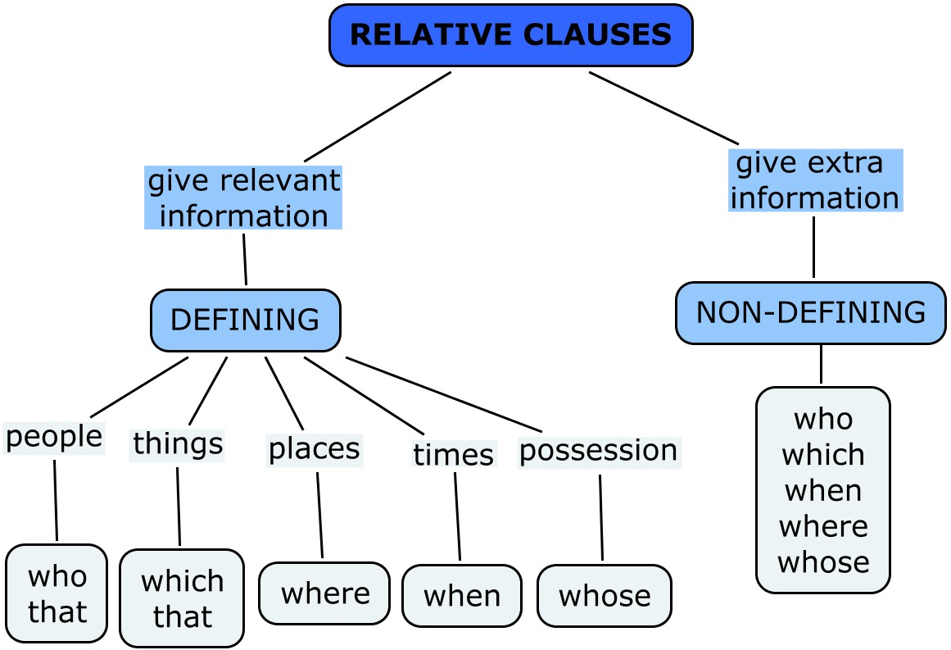

Slide 11
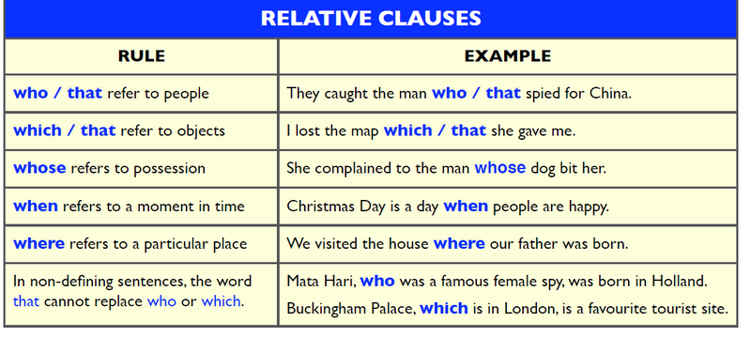

Slide 12
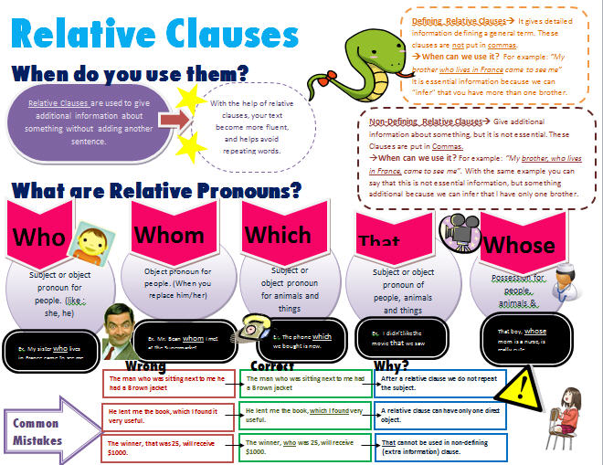

Slide 13
KOKKUVÕTE
Oluline on see, et Te mõistaksite, millist asesõna kasutada erinevates lausetes selleks, et siduda pealauset ja kõrvallauset. (N: who, whom, that jne)
Teiseks peate Te teadma, millal kasutada komasid. Kui on oluline info, siis koma puudub. Kui on täiendav info, siis peate kasutama komasid.
Järgnevalt harjutage erinevatel linkidel!

Slide 14
Practise!
https://www.englisch-hilfen.de/en/exercises/pronouns/relative_pronouns.htm
https://www.englisch-hilfen.de/en/exercises/pronouns/relative_pronouns2.htm
http://www.eflnet.com/grammar/relpronoun.php
https://www.ego4u.com/en/cram-up/grammar/relative-clauses/exercises?04

Slide 15
References
http://topenglishlessons.net/relative-pronouns/
https://en.islcollective.com/resources/printables/worksheets_doc_docx/relative_pronouns/relative-clauses-preintermediate/19264
https://www.eslbuzz.com/english-grammar-relative-pronouns/
http://teachinginkoreanuniversity.com/how-to-teach-relative-clauses/
https://englishfl3eso.wikispaces.com/Relative+Clauses
https://english-grammar-activities.wikispaces.com/M-+RELATIVE+CLAUSES
https://fingertipsenglish.com/trinity/relative-clauses-ise-ii-trinity-grammar-function/
http://busyteacher.org/8844-relative-clauses-and-pronouns-cheat-sheet.html

