Slide 1
PAST SIMPLE, PRESENT PERFECT AND PRESENT PERFECT CONTINUOUS
Author: Sixten Hinnov

Slide 2


Slide 3
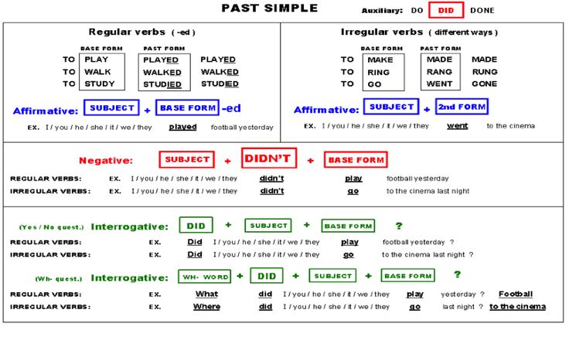
Past Simple - Lihtminevik

Slide 4
Kasutamine
Harjumused minevikus.
Lõpetatud tegevus minevikus.
Alati ei pea olema ajamääruseid lauses.
Abistavad sõnad: last week (month,year, century), yesterday, ago, already, from-to jne

Slide 5
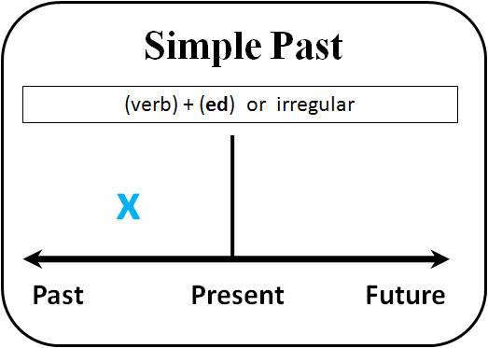

Slide 6
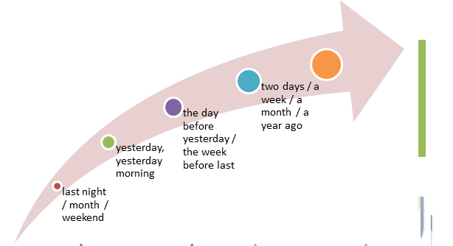

Slide 7
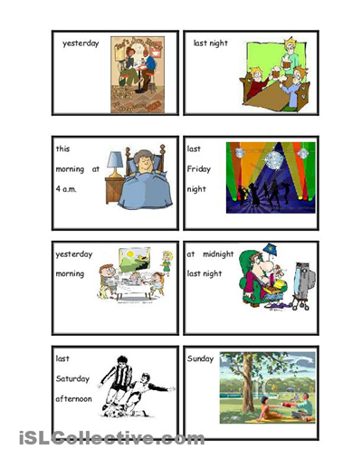

Slide 8
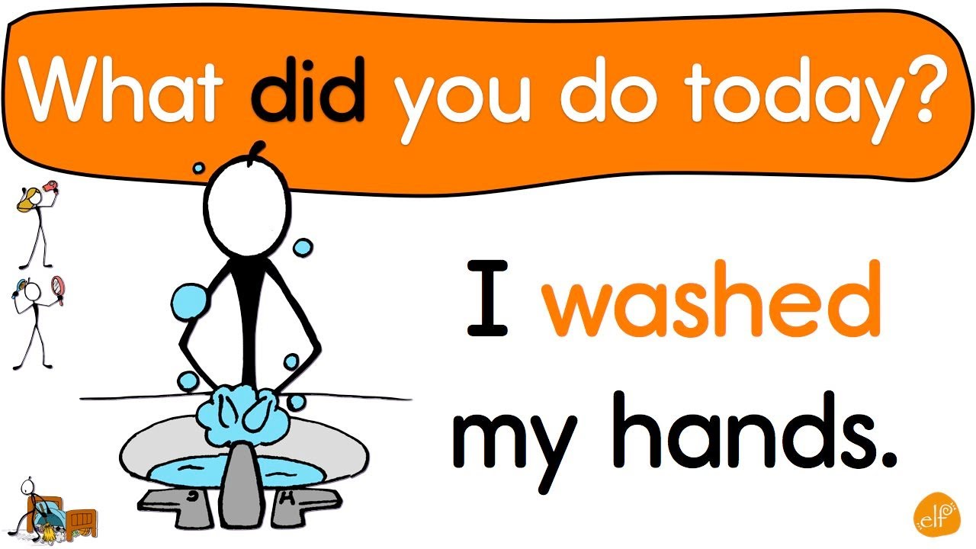

Slide 9
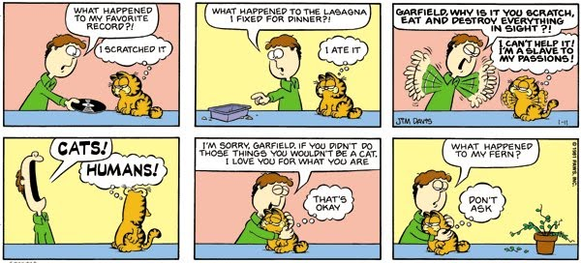

Slide 10
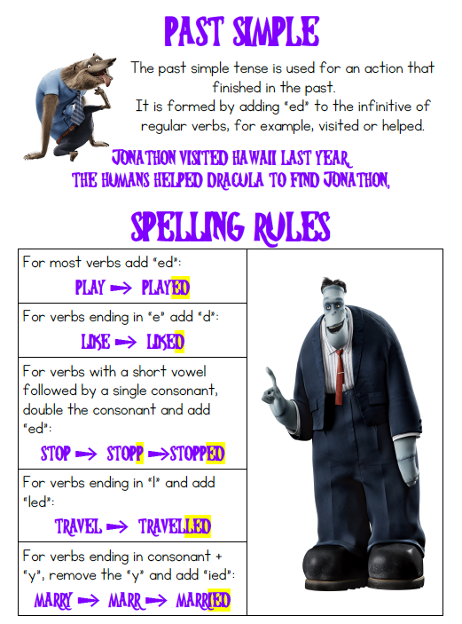

Slide 11
Activities
https://www.ego4u.com/en/cram-up/grammar/simple-past
http://www.myenglishpages.com/site_php_files/grammar-exercise-simple-past.php

Slide 12


Slide 13
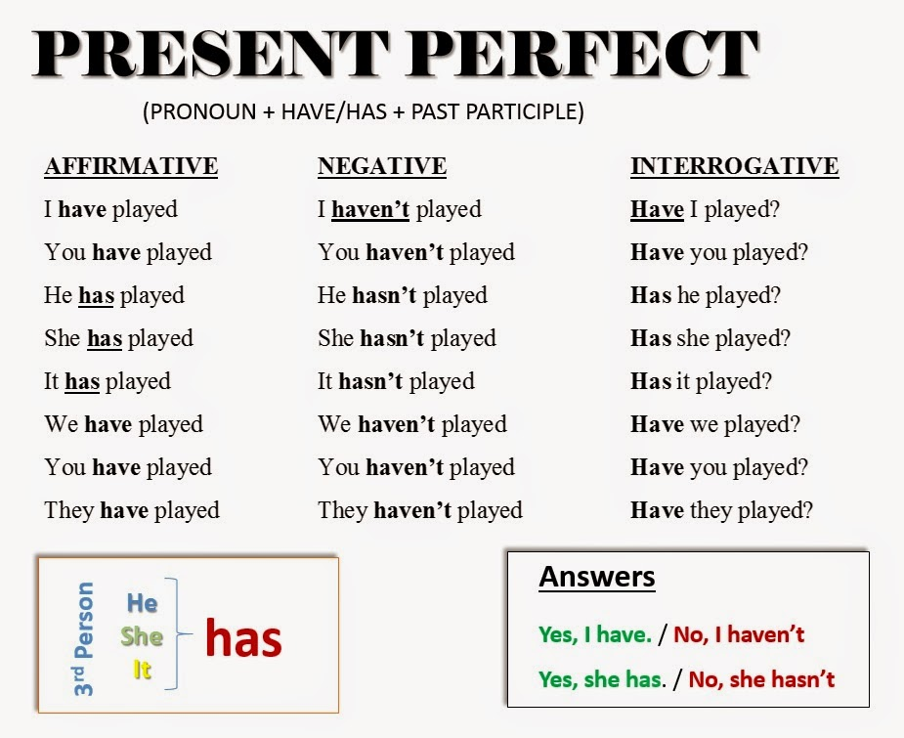
Present Perfect – Täisminevik
Have/has + III (-ed)

Slide 14
Kasutamine
Tegevus algas minevikus, kuid tulemus on oluline kõne momendil.
Kasutame saavutuste ja kogemuste kirjeldamiseks.
Pole väga oluline, kuna miski juhtus minevikus. Aeg pole väga täpne.
Abistavad sõnad: since, for, yet, already, just, recently, lately, this morning, so far, today, till now.

Slide 15
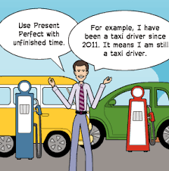

Slide 16
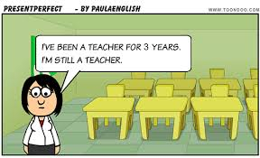

Slide 17
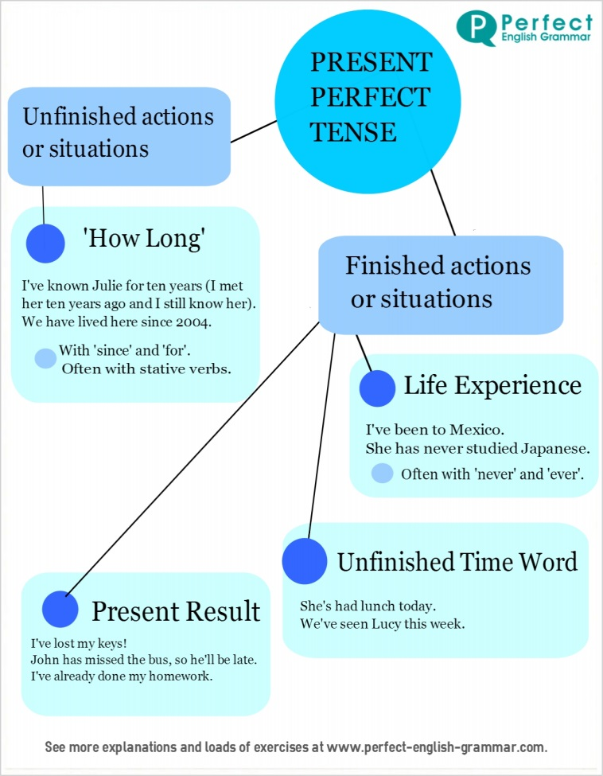

Slide 18
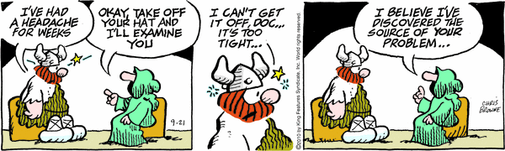

Slide 19
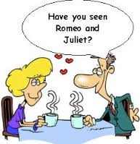

Slide 20
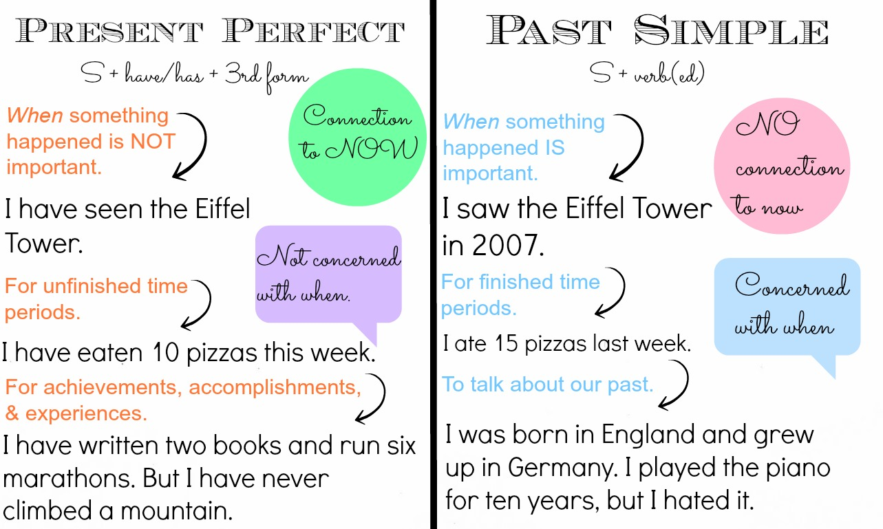

Slide 21
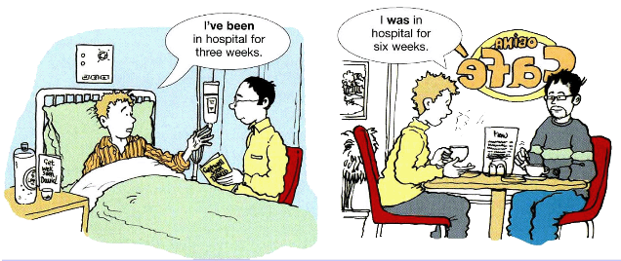
Lihtmineviku ja täismineviku erinevus.

Slide 22
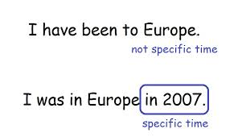
Lihtmineviku ja täismineviku erinevus

Slide 23
Activities
http://www.agendaweb.org/verbs/present_perfect-exercises.html
http://www.englishpage.com/verbpage/verbs6.htm

Slide 24
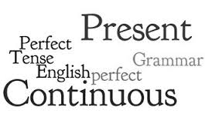

Slide 25
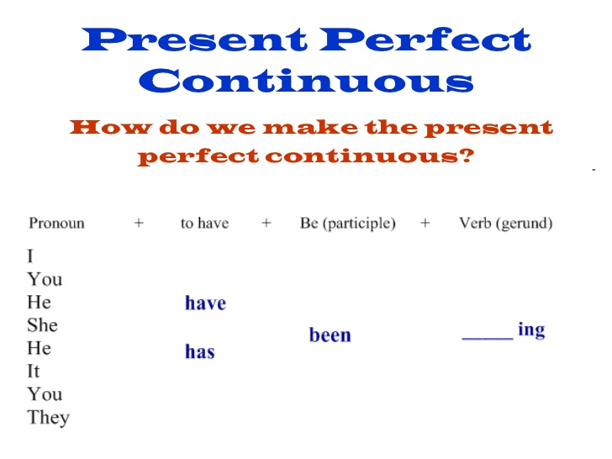
Present Perfect Continuous

Slide 26
Kasutamine
Kasutame siis, kui räägime tegevusest, mis algas minevikus, kestab praegu ja läheb edasi ka tulevikus.
Rõhk on tegevuse kestvusel.
Abistavad sõnad on samad, mis täisminevikus.

Slide 27
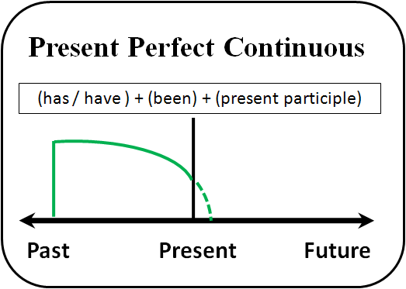

Slide 28
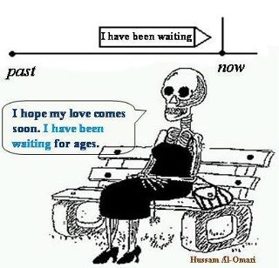

Slide 29
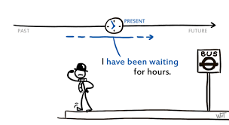

Slide 30
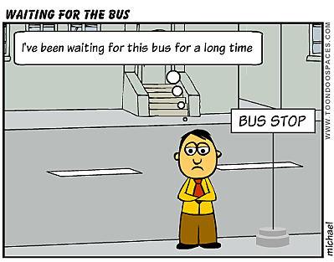

Slide 31
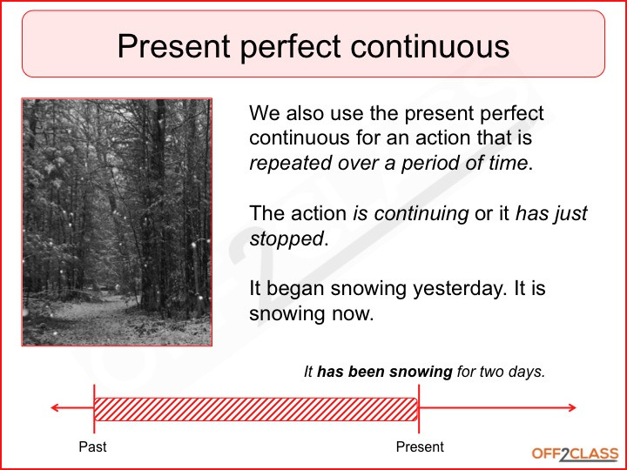

Slide 32
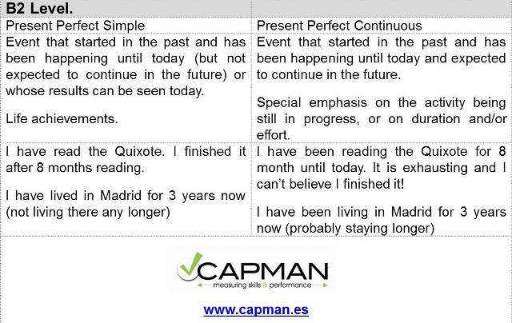

Slide 33
Activities
http://www.englishpage.com/verbpage/verbs7.htm
http://www.englishpage.com/verbpage/verbs8.htm

Slide 34
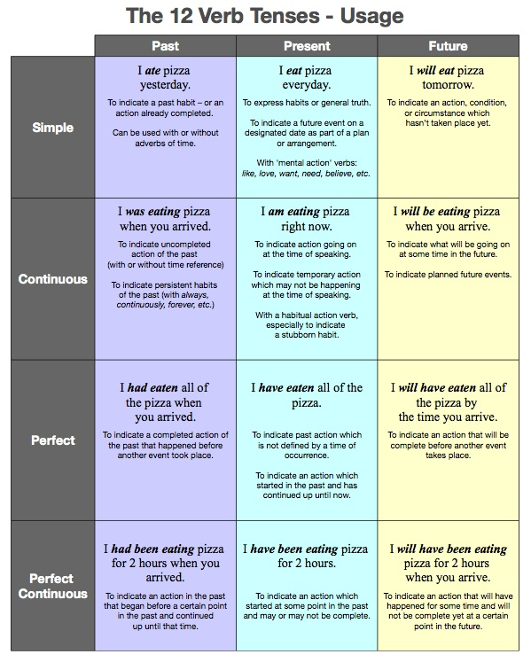

Slide 35
References for the pictures
https://www.youtube.com/watch?v=0Ri3QTT41f8
https://www.pinterest.co.uk/pin/604115737485870441/?lp=true
https://www.pinterest.co.uk/pin/604115737485870441/?lp=true
http://ozgurergul020.blogspot.com.ee/p/simple-past-tense.html
http://wordsinactioningama.blogspot.com.ee/2014/08/past-time-expressions.html
http://www.tt-group.net/en/creative-corner/mind-map-the-past-simple-tense/
https://www.youtube.com/watch?v=0b4rsDuzThE
http://teacherbruno1.blogspot.com.ee/2013/06/garfield-simple-past.html
https://www.pinterest.com/pin/43487952632187649/?lp=true

Slide 36
https://www.tes.com/lessons/CXnfSr_5G7zxmA/present-perfect
https://www.pixton.com/embed/qhqyf6wm
https://mind42.com/public/99528574-ee4b-4536-bc23-62373a129432
https://mind42.com/public/449ff4a6-2589-48ec-8eae-9fa61004fbc7
http://myblog-inplainenglish.blogspot.com.ee/2014/10/simple-past-or-present-perfect.html
https://www.tes.com/lessons/nQPH1EJIN0uSAQ/present-perfect-simple-simple-past
https://idiomaextra.wordpress.com/2014/01/29/grammar-guru-94/
https://myenglishspot.wordpress.com/2016/10/24/present-perfect-tenses/
http://sundayportuguese.blogspot.com.ee/2013/03/present-perfect-continuous.html
https://content.cambly.com/2017/02/03/lesson-20-present-perfect-continuous/
https://mrsfjenglish.weebly.com/present-perfect-continuous.html
https://learningenglishvocabularygrammar.com/grammar/grammar-pdf/12-verb-tenses-english-grammar

