Slide 1
The Infinitive vs Gerund
Author: Sixten Hinnov

Slide 2


Slide 3
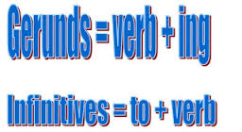

Slide 4
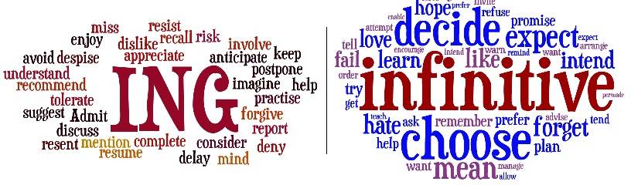

Slide 5
Common verbs which are followed by the GERUND
Admit, appreciate, consider, delay, deny, detest (põlgama), end up, enjoy, escape, face, feel like, finish, forgive, give up, imagine, involve, mention, mind, miss, postpone, practise, prefer, put off, remember, recommend, resent, risk, strat, suggest, understand.
Example: I´m considering asking Jessica to help me.

Slide 6
Common verbs followed by an INFINITIVE
Afford, aim, agree, appear, arrange, ask, attempt, be able to, bear, begin, care, choose, consent (nõustuma), decide, determine, expect, fail, forget, happen, hate, hesitate, hope, intend, keen, learn, manage, mean, offer, plan, prefer, prepare, pretend, promise, propose, refuse, remember, seem, start, swear, try, want, wish, (would) like.
Example: He asked me to help him.

Slide 7
Common verbs followed by an INFINITIVE WITOUT TO
Let, make, hear, help, see, would rather/had better, modals (can, could, shall, should, will, would, must).
Example: Her parents won´t let her stay out late.
NB! In passive sentences make, hear, help are followed by an infinitive with to.
Example: He was made to report to the police.
Let cannot be used in the passive form. Instead allowed must be used.
Example: I am allowed to stay out late by my parents.

Slide 8
These verbs can be followed by either the gerund or the infinitive.
Begin, start, like, dislike, hate, love, intend, continue, regret, stop, try.
Example: I stopped drinking coffee because it kept me awake at night.
We stopped to have a coffee on the way home.

Slide 9
Practise!
https://www.eslbuzz.com/verbals-gerunds-infinitives-and-participles/ (Rules)
https://www.perfect-english-grammar.com/gerunds-and-infinitives-exercise-2.html
https://www.perfect-english-grammar.com/gerunds-and-infinitives-exercise-1.html

Slide 10
References
Wyatt R. Newbrook J. Wilson. J. 2008. FCE Gold Plus. Essex: Pearson/Longman.
http://inmadom-myenglishclass.blogspot.com.ee/2014/01/gerund-or-infinitive.html
https://www.itefli.com/teflblog/grammar-for-tefl-teachers-gerunds-and-infinitives/
https://englishsecrets.wordpress.com/2015/01/06/gerund-or-infinitive-i/

